Slide 1

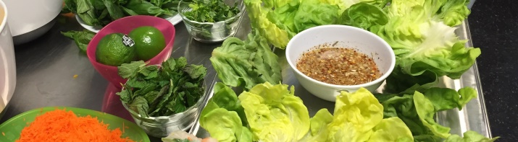

Creating Collaborative Capacity Developing and Sustaining Better School Wellness Councils
Building Wellness for Life
David Lounsbury, PhD
Community Psychologist
Albert Einstein College of Medicine
Bronx, NY
Notes:
My name is David Lounsbury. I am a community psychologist with expertise in public health research and systems thinking.
I am part of the research team for this study, which is funded by the National Institute of Diabetes and Digestive and Kidney Diseases.
I am helping to develop a toolkit for use by School Wellness Councils. Our toolkit is a companion to the Alliance for a Healthier Generation’s on-line program and to the NYC Office of School Wellness portal.
This presentation is all about CREATING COLLBORATIVE CAPACITY to help you and other wellness champions in your school develop and sustain better school wellness councils.

Slide 2

What does creating collaborative capacity have to do with school wellness?
Capacity: The resources and conditions required to do, experience, or understand something
Collaboration: Working together towards a shared goal
Collaborative capacity: The resources and conditions needed to work together to achieve a shared goal
Creating collaborative capacity will help you and other wellness champions leverage opportunities, priorities, and preferences that promote health behavior change among students and staff
Notes:
Collaboration is about working together, working in partnership, to achieve a goal. By working together we have the potential to achieve shared goals for school wellness better, faster, and with greater reach to more students and staff in our schools.
However, working together does not always come easily. Whether you are a HealthCorps Coordinator, a student, a teacher, the principal, a parent, or any other stakeholder at school, chances are your time in short and you have many different, competing priorities.
In order to find a way to work effectively together, you need to create collaborative capacity.
Although there is no one best way to build partnerships, there is a framework that we find does an excellent job of explaining the conditions, or components, that are needed to create collaborative capacity.
We hope that this framework is helpful to establishing and working with your School Wellness Council.

Slide 3
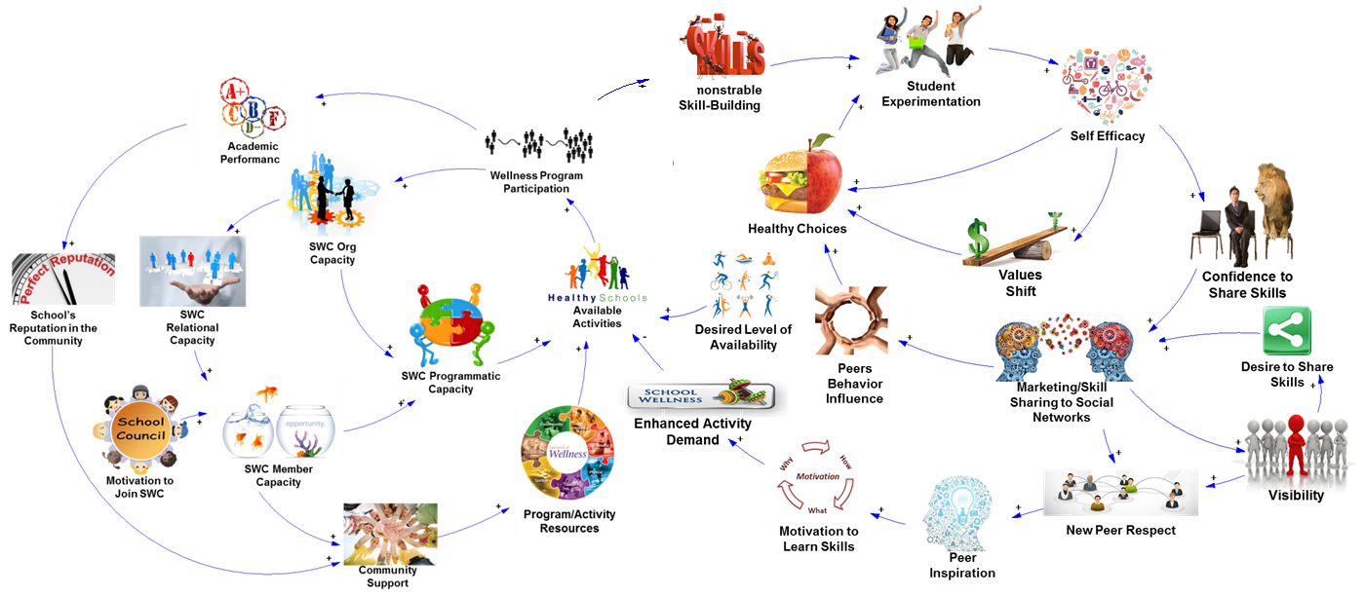
Building Wellness for Life
School Level
Demonstrable
Skill-building
Student Level
Notes:
In the Better Wellness for Life introduction, we showed how systems thinking helps us understand how make positive changes at two levels, at the level of the school and among individual students. Both are important, and, as we can see, progress at either level is interdependent. When your school launches a new, skill-based wellness activity for students, that cycles back to support development and encourage participation in your School Wellness Council. So, let’s focus on making positive change at the school level.

Slide 4

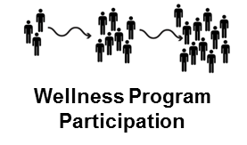







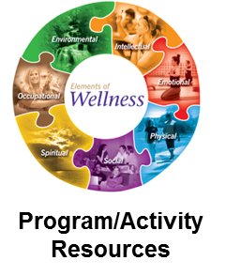

Building Wellness for Life
Collaborative Capacity
SWC Org Capacity
School’s Reputation in the Community
SWC Relational Capacity
Available Activities
+
SWC Programmatic Capacity
+
SWC Member Capacity
4 critical components (see Foster-Fishman, Berkowitz, Lounsbury, Jacobson, and Allen, 2001)
Motivation to Join SWC
Notes:
Collaborative capacity is defined by four critical components, or sources, namely relational capacity, member capacity, organizational capacity and programmatic capacity. Each of these is essential to creating collaborative capacity. And each is dynamically related to the other, so as one component grows and develops, so to with the others, and visa versa. And, over time, as shown here, collaborative capacity will have direct impact on making more activities that foster wellness in students available. It will also help build community support for wellness, which means your school will likely find new resources to help make wellness activities more available in your school.

Slide 5
Relational capacity: Trust, respect, and strong rapport among wellness champions
Building Wellness for Life
SWC Relational Capacity
Foster positive internal relationships among wellness champions: Do members know and like each other?
Value member diversity: Give all members voice.
Build external relationships: Parents, DOE Office of School Wellness; local libraries, places of worship, etc.
Notes:
Relational capacity is about trust, respect and about building strong rapport among your wellness champions.
It’s about building positive internal relationships. As a facilitator for your SWC, try to create reasonable, group norms about participation, member involvement, meeting behavior, and that celebrates individual and group successes.
It’s also about valuing member diversity: Where ever possible, try encourage SWC members to voice unique concerns, and then try to translate these concerns into novel, exciting new ideas for wellness activities in your school.
Building external relationships is also important to create relational capacity. Are there organizations or agencies in the community that could be represented on your SWC? Consider results of your HC Community Assessment exercise. Consider reaching out to the Alliance, or the DOE Office of School Wellness.
Ultimately, relational capacity is about co-learning, shared decision-making, and mutual ownership of the processes and the products of the project.

Slide 6
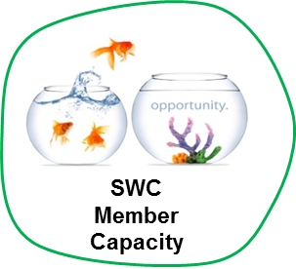
Member capacity: Skills and knowledge that help wellness champions work together
Building Wellness for Life
Foster belief in self, others and in the notion of ‘collaboration’ for school wellness
Allow open discussion about wellness challenges and about ways to address them
Turn challenges into novel, exciting new wellness activities
Notes:
Member capacity comes from skills and knowledge that help people work well with each other. It’s really about developing communication skills. In short, it’s about fostering belief in self, others and in the notion of ‘collaboration’ for school wellness.
Allow open discussion about wellness challenges and about ways to address them.

Slide 7


Organizational capacity: Ability to support, design, and carry out SMART action plans
Building Wellness for Life
Consider ways work with school systems and resources, like food service, gym, library, student clubs (art, debate, sports)
Students may be your best allies: Build a strong student leadership team
Keep all SWC members abreast of meeting and activities
Notes:
Organizational capacity is really just your SWC’s ability to support, design, and carry out SMART action plans.
Consider ways work with school systems and resources, like food service, gym, library, student clubs (art, debate, sports).
Keep in mind that students may be your strongest allies: Build and sustain a student leadership team, which may be as few as one or two students, but ideally is group of about 5 or 6. They will appreciate the opportunity to take on this role, and you will have a great resource for idea-generating, for mounting activities, and for collecting information to help evaluate your successes and find way to expand activities, down the road.
Make sure to find ways to keep all SWC members abreast of meeting and activities. Social media and school websites may be particularly useful ways to get the work out.

Slide 8


Programmatic capacity: Implementing your SMART goal(s)? Which one(s) will your SWC pursue?
Building Wellness for Life
Address one or more health behavioral goals by choosing a Share Activity (Fitness Share, Make-One-Share-One, Yoga Share) to support your SWC’s SMART goal
Use evaluation and feedback tools and processes: Healthy-Me-Meters; SWOTS; etc.
Implement skill-based activities that are consistent with U.S. Dietary Guideline key health behaviors
Notes:
Programmatic capacity is getting to the fun stuff: Actually carrying out your wellness activities in school, with your SMART goal as a plan for carrying it out well. Review the information we have provided on various SHARE ACTIVITIES, namely fitness share, MOSO, and Yoga Share.
Knowing what worked and what didn’t is part of best practice. We have provided a number of evaluation tools and measures that you can use to document success and learn how to continually improve the wellness activity in your unique school setting.
Again, implementing skill-based activities will maximize your opportunity to promote key health behavior changes among students.

Slide 9




How to start building collaborative capacity?
SWC Org Capacity
SWC Relational Capacity
SWC Programmatic Capacity
Think relational capacity!
Engage just one other person
you would like to work with,
and start together, right there, right then.
And then watch your school’s collaborative capacity start to grow!
SWC Member Capacity

Slide 10

Aggregate Healthy-Me-Meter
School A
Fall 2014
N = 137 students
Aggregate Healthy-Me-Meter Reports: Great conversation starters!
Notes:
Try talking about your school’s Healthy-Me-Meter reports. Here’s an example. At this school students reported that they are not doing so well with eating 2 ½ servings of fruits and vegatables a day. In fact, 91% of students in this school’s sample need a lot of improvement on this. Interestingly, they also reported that they are “DOING GREAT” in terms of cutting back on fast food and sugary beverages. That seems surprising, and may require some careful deliberation. Is this self-reported data biased? Use this kind of finding as a conversation starter.

Slide 11
Aggregate Healthy-Me-Meter
School A
Fall 2014
N = 137 students
More food for thought!
Notes:
Here is more data from the same sample of school students. About 60% reported that they need help finding exercise partners. And about half say they are not getting enough sleep or physical activity. Each of these findings may prompt ideas about SMART wellness activities your SWC could try out.

Slide 12
What to do when collaboration slows or even stops?
SWC Org Capacity
SWC Relational Capacity
SWC Programmatic Capacity
Lots of things will work against your SWC’s efforts.
For example, lack of time, energy, resources, or progress that’s just too slow.
SWC Member Capacity
When that happens, review your systems thinking!
Notes:
Collaborating is not easy. Lots of things will work against your SWC’s efforts: Lack of time, energy, resources or just too slow progress
What should you do when collaboration slows or even stops? When that happens, apply your systems thinking!

Slide 13
Building Wellness for Life
School Level
Demonstrable
Skill-building
Student Level
Notes:
Recall our systems thinking framework. Be mindful of how collaborative capacity at the school level promotes positive change in wellness at the student level. It all comes together when your school can offer MORE wellness activities and can engage MORE student participation.

Slide 14

Thank You!
David Lounsbury, PhD
David.Lounsbury@einstein.yu.edu
Notes:
Thank you for listening. We wish you great success with your SWC. If you want more information or more assistance, just reach out.

